Slide 1


Next Gen Employability Program
Books Avenue: Online Book Store Platform
Team Details – NG_CP_Team_4333
Name: Shivam Bharad
Name: Shridhar Joshi
Name: Kartik Jadhav
College: KJEI’s Trinity Academy of Engineering

Slide 2

Books Avenue
Project Title :
Notes:
In this slide speaker will be introducing the program and its outcomes. The speaker will introduce himself in brief

Slide 3


Table of Contents:
Introduction
Problem Statement
Objectives
Scope of the Project
System Architecture
Technology Used
Future Scope
Learning Outcomes
References

Slide 4

Books Avenue is an online book shopping platform designed to make book discovery and purchasing easier and more convenient. It provides a user‑friendly interface that allows readers to browse, search, and order books from anywhere, reducing the need to visit physical stores. Developed using the Django Framework, the system ensures secure data handling and efficient performance. The platform offers a wide range of books, making it a one‑stop solution for book lovers.
Introduction

Slide 5

Problem Statement :
Stores often have a limited collection
No single platform to find and manage all books.
Hard to get rare titles and digital books.
Buying books from local stores takes too much time.

Slide 6

Objective :
To help manage books, users, and orders
To ensure secure and efficient data handling
To design an online platform for book purchasing.
To provide easy search and category-based browsing

Slide 7






Technology Used
CSS
Styles the visual appearance of website.
HTML
Structures the content and layout of web pages.
JS
Add interactivity to the site.
Python
Django
Provides a secure and scalable web framework.
SQLite
Stores data.
Powers the backend logic and server side operation.

Slide 8
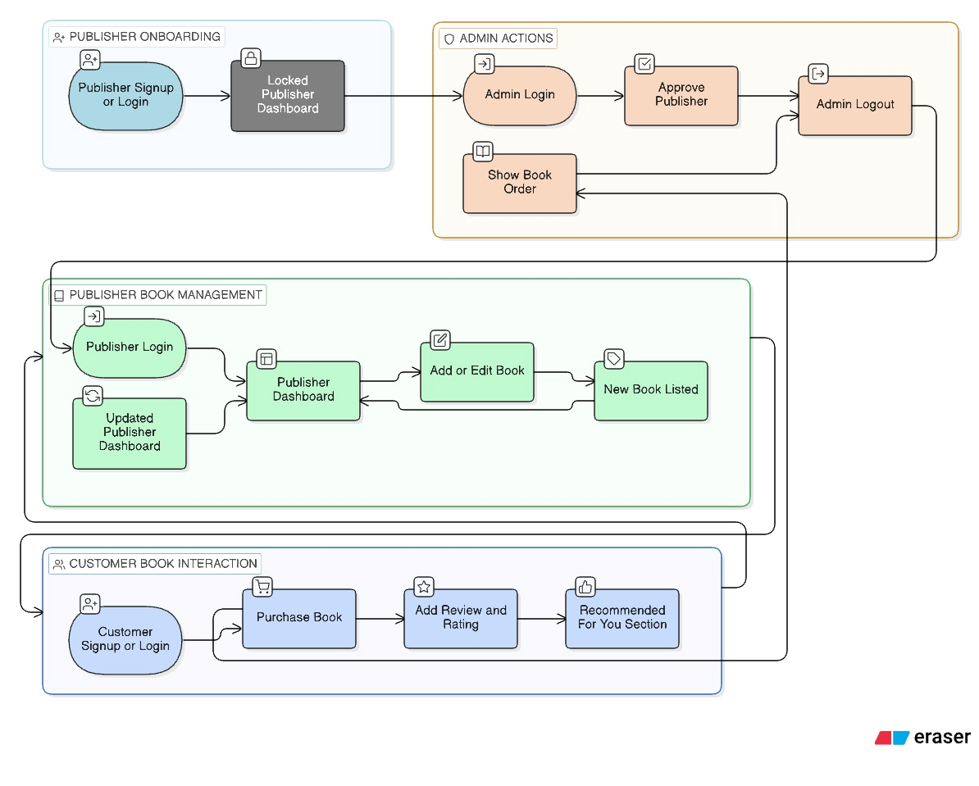
System workflow :

Slide 9


Future scope :
AI-based Book Recommendations
Audiobook Support
Subscription Plans
Multi-language support

Slide 10

Learning Outcomes :
Learned how to work with databases — saving, updating, and linking data easily.
Learned how to keep accounts safe with logins, passwords, and protection from attacks.
Connected the website’s design, backend code, and database so everything works together smoothly.
Understood that a clean and simple design makes the site easier to use and keeps users happy.

Slide 11
References :
https://www.w3schools.com/
https://www.amazon.in/books
https://www.flipkart.com/books
https://docs.djangoproject.com/

Slide 12
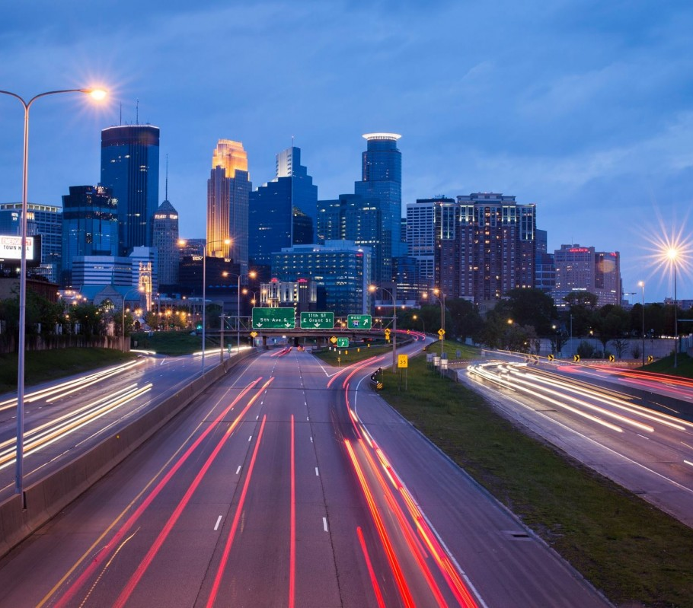
THANK YOU

